Slide 1
LIPID METABOLISM

Slide 2
Stages And Reaction Steps Of Beta Oxidation Of Fatty Acids

Slide 3
Three Stages Of Beta Oxidation For Oxidation Fatty acid Palmitate

Slide 4
Stage I
Activation of
Long Chain Fatty acid (Acyl Chain)
To
Acyl-CoA In Cytosol
Palmitate to Palmitoyl-CoA
In Cytosol

Slide 5
Stage II
Translocation of Activated Fatty acid
From Cytosol into Mitochondrial Matrix
Through Role of Carnitine
(Carnitine Shuttle)

Slide 6
Stage III
Steps of Beta Oxidation Proper
In Mitochondrial Matrix
Oxidation Reaction
Hydration Reaction
Oxidation Reaction
Cleavage Reaction

Slide 7
Stage I Activation Of Fatty acid In Cytosol Is a Preparative Phase

Slide 8
Site Of Fatty acid Activation
Fatty acid(Acyl Chain) is activated in Cytosol to Acyl-CoA .

Slide 9
Requirements of FA Activation
Enzyme:
Thiokinase /Acyl CoA Synthetase
Coenzymes/Cofactors:
CoA-SH derived from Pantothenic acid
ATP
Magnesium ions (Mg⁺⁺)

Slide 10
CoezymeA (CoA-SH) Activates Fatty Acids for Beta Oxidation
Notes:
6

Slide 11
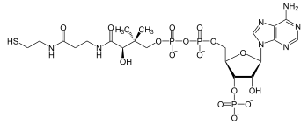

CoA Helps in
Activation of Fatty Acid

Slide 12
A long chain Fatty acid is termed as Acyl chain.
Every Fatty acid which undergoes β Oxidation of Fatty acid is first activated to Acyl-CoA.

Slide 13
Activation of a
Fatty acid means:
Linking of Acyl Chain to Coenzyme A to form Acyl-CoA with a high energy bond.

Slide 14
During Activation of
Fatty acid (Acyl Chain)
‘H’ of CoA-SH (Coenzyme A) is substituted by Acyl chain
To form CoA-S Acyl, i.e. Acyl-CoA an activated Fatty acid.

Slide 15
Thus CoenzymeA is a carrier of Acyl chain in an activated fatty acid.

Slide 16
Steps Of Fatty Acid Activation

Slide 17
Activation Of a Fatty Acid Is ATP Dependent Converts ATP to AMP Hence Requirement is equivalent to 2 ATPs

Slide 18
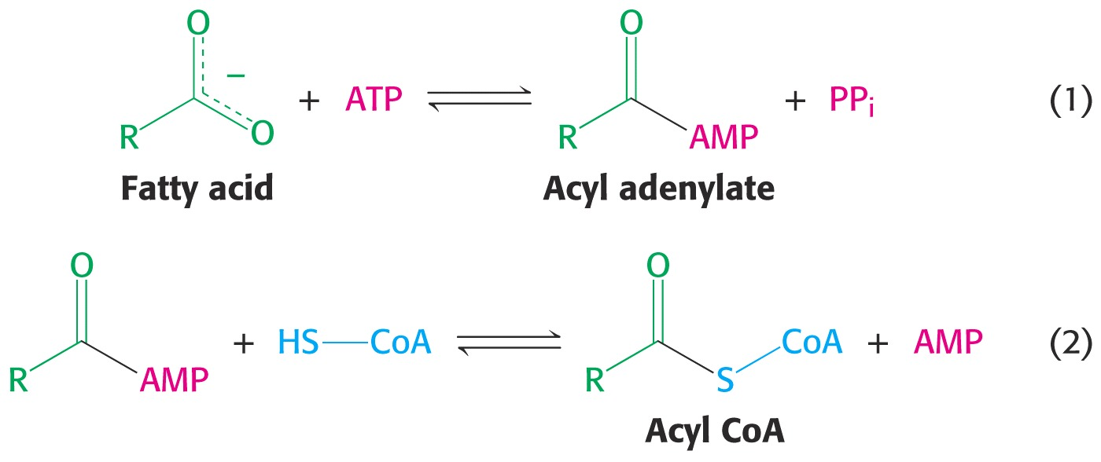

Slide 19
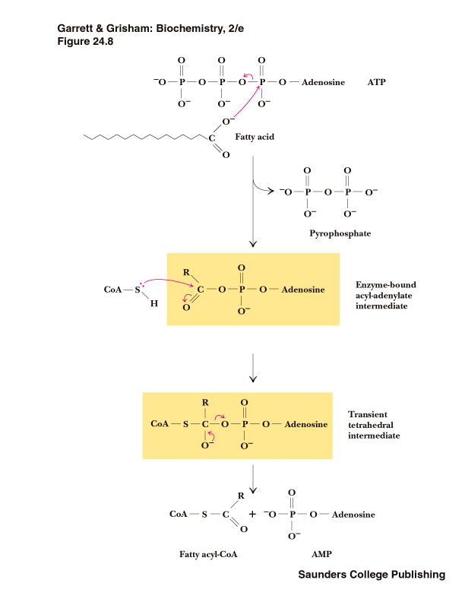

Slide 20
Acyl-CoA Synthetase/
Fatty Acid Thiokinase
condenses Fatty acids with CoA, with simultaneous hydrolysis of ATP to AMP and PP_{i}

Slide 21
An Acyl-CoA is an activated energetic compound having high energy bond in it.

Slide 22
Thus formation of Acyl–CoA is an expensive energetically

Slide 23
Fatty acid Activation
Activation of Fatty acids is esterification of Fatty acid with Coenzyme A
In presence of Acyl-CoA Synthetase (Thiokinase) forming an activated Fatty acid as Acyl-CoA.
This process is ATP-dependent, & occurs in 2 steps.

Slide 24
During the activation of Fatty acid ATP is converted to AMP and ppi.
Two high energy bonds of ATP are cleaved and utilized in this activation which is equivalent to 2 ATPs.

Slide 25
Subsequent hydrolysis of PP_{i} from ATP drives the reaction strongly forward.
Note the Acyl- Adenylate is an intermediate in the mechanism.

Slide 26
There are different Acyl-CoA Synthetase for fatty acids of different chain lengths.

Slide 27
Activated Fatty Acid (Acyl-CoA) is a High Energy Compound Which Facilitates Second Stage Of Beta Oxidation Of Fatty Acid

Slide 28
Stage II Translocation Of Acyl-CoA From Cytosol Into Mitochondrial Matrix With The Help Of Carnitine

Slide 29
β-oxidation proper occurs in Mitochondrial matrix.

Slide 30
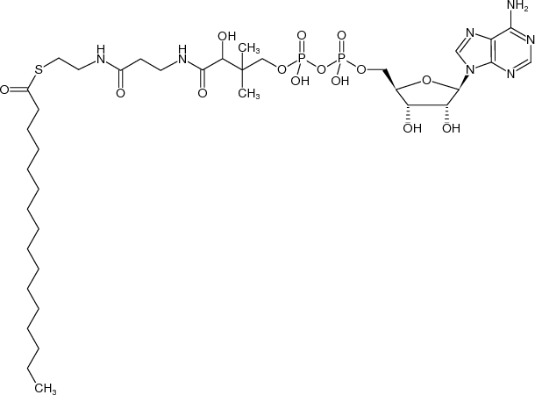
CoA is a complex structure.
CoA part of Palmitoyl-CoA is impermeable to inner membrane of Mitochondria

Slide 31
Long-chain Fatty acids more than 12 Carbon atoms cannot be directly translocated into the Mitochondrial matrix.
However short chain Fatty acids are directly translocated into the Mitochondrial matrix

Slide 32
To translocate an activated long chain Fatty acid (Acyl-CoA) from cytosol to mitochondrial matrix
Across mitochondrial membrane operates a specialized Carnitine Carrier System.

Slide 33
What Is Carnitine?
Carnitine is a functional, Non Protein Nitrogenous (NPN) substance.
Carnitine is biosynthesized in the body by amino acids Lysine and Methionine.

Slide 34
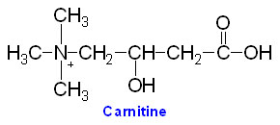
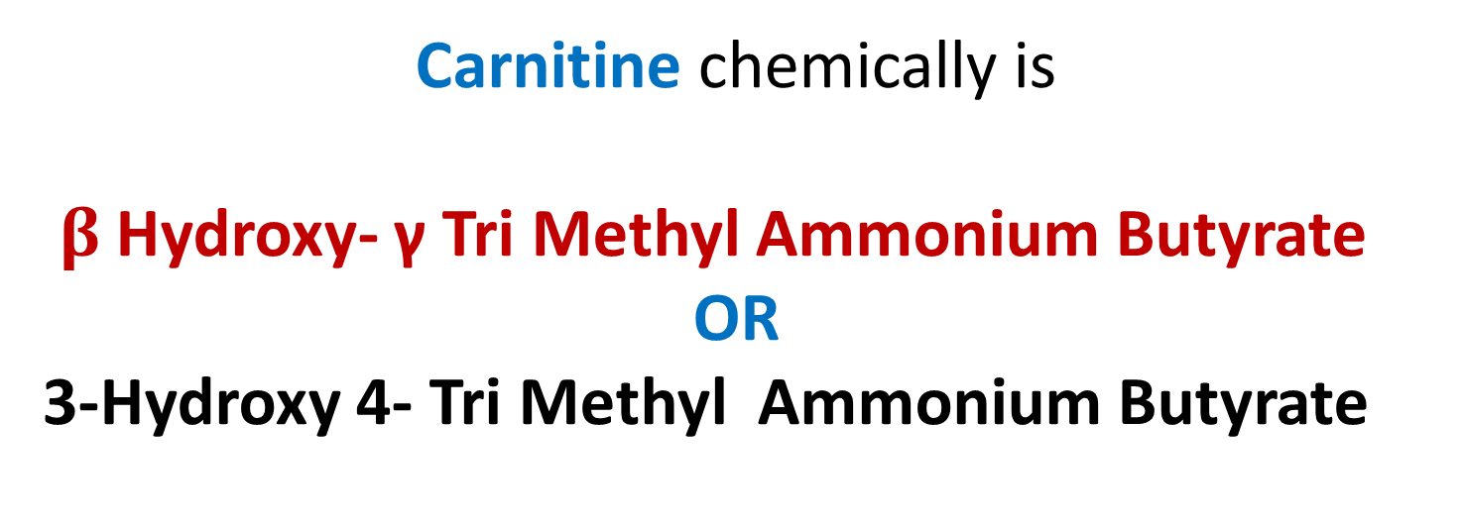
Carnitine chemically is
$β$ Hydroxy- γ Tri Methyl Ammonium Butyrate
OR
3-Hydroxy 4- Tri Methyl Ammonium Butyrate

Slide 35
Long chain Acyl CoA traverses an inner mitochondrial membrane with a special transport mechanism called Carnitine Shuttle.

Slide 36
Significance Of Acyl-CoA Formation
High energy bond of Acyl-CoA releases high energy which helps in condensation of Acyl with Carnitine for further translocation.

Slide 37
Mechanism Of Carnitine In Transport Of Fatty Acyl CoA From Cytosol To Mitochondrial Matrix

Slide 38
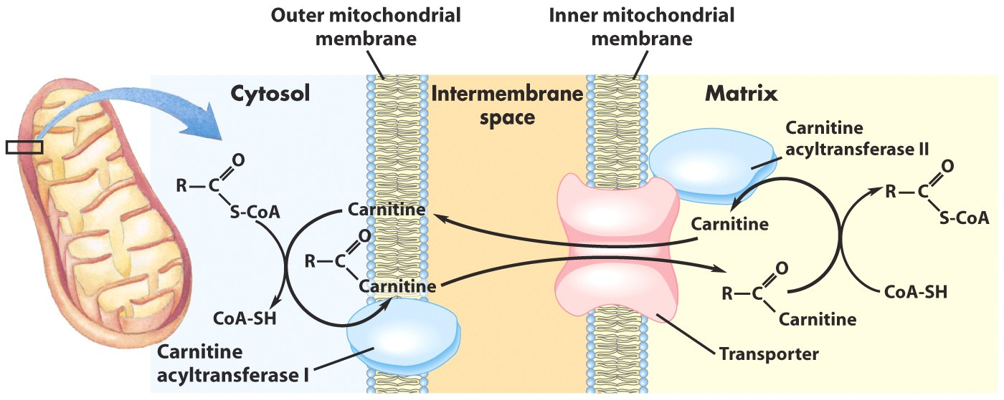

Slide 39
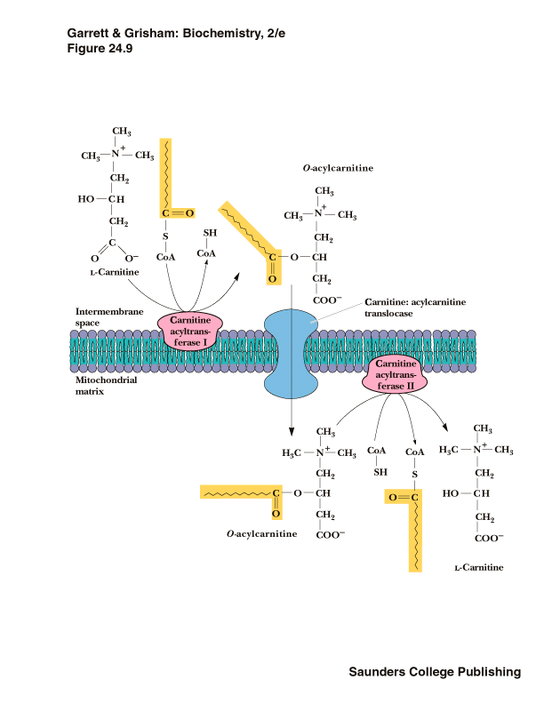

Slide 40
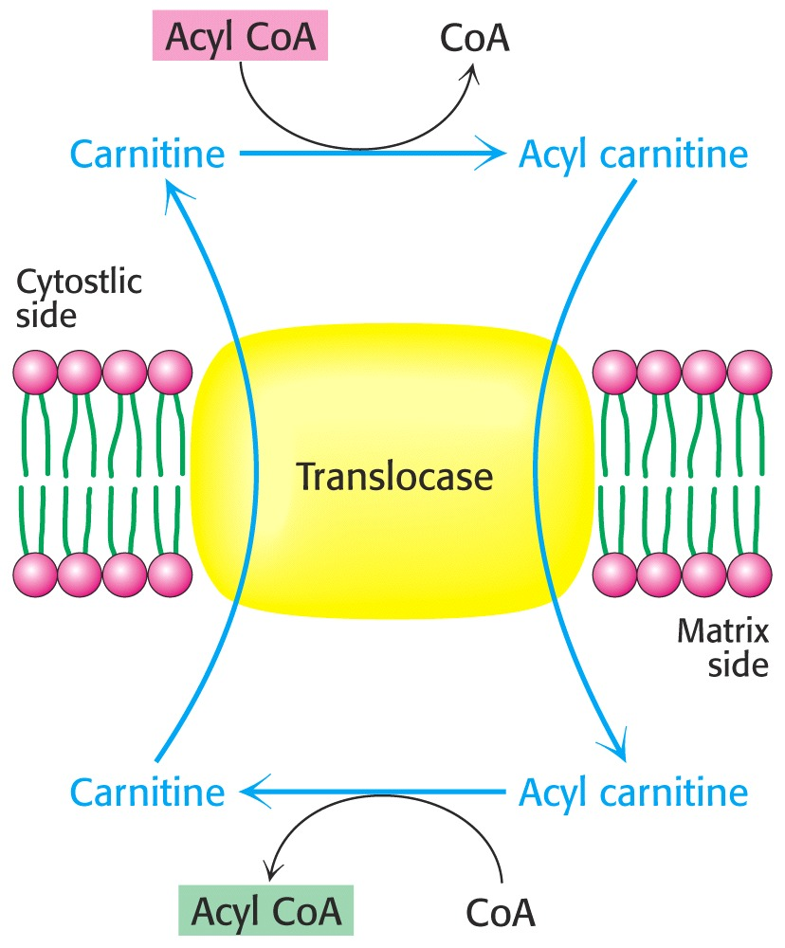

Slide 41
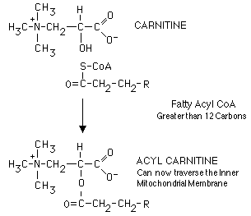

Slide 42
Acyl-CoA a high energy compound cleave its high energy bond in second stage.
Bond energy released is used up for linking Carnitine to Acyl chain to form Acyl-Carnitine.

Slide 43
Long-chain FA are converted to Acyl Carnitine and are then transported
Acyl-CoA are reformed inside an inner membrane of mitochondrial matrix.
Notes:
7

Slide 44
Acyl groups from Acyl-COA is transferred to Carnitine to form Acyl- Carnitine catalyzed by Carnitine Acyl Transferase I (CAT I)
CAT I is present associated to outer mitochondrial membrane
.
Acylcarnitine is then shuttled across an inner mitochondrial membrane by a Translocase enzyme.

Slide 45
Acyl group is linked to CoA of Mitochondrial pool in mitochondrial matrix by Carnitine Acyl Transferase II (CAT II) to regenerate Acyl-CoA in mitochondrial matrix.
Finally, Carnitine is returned to cytosolic side by Protein Translocase, in exchange for an incoming Acyl Carnitine.

Slide 46
Points To Remember
Cell maintains two separate pools of Coenzyme-A:
Cytosolic pool of CoA
Mitochondrial pool of CoA

Slide 47
CoA is complex structure cannot transport across Mitochondrial membrane
CoA linked to Fatty acid in Mitochondria is different from that CoA used for Fatty acid activation.

Slide 48
Translocation of Palmitoyl-CoA Across Mitochondrial Membrane

Slide 49
ATP + CoA
AMP + PP_{i}
palmitate
palmitoyl-CoA
Cytoplasm
OUTER
MITOCHONDRIAL
MEMBRANE
ACS
CPT-I
[1]
[2]
CoA
palmitoyl-CoA
Intermembrane
Space
carnitine
palmitoyl-carnitine
Activation of Palmitate to Palmitoyl CoA and conversion to Palmitoyl Carnitine

Slide 50
CPT-I
palmitoyl-CoA
CoA
Intermembrane Space
Carnitine
Palmitoyl-Carnitine
[3]
INNER
MITOCHONDRIAL
MEMBRANE
CAT
Matrix
CPT-II
Carnitine
palmitoyl-carnitine
[4]
palmitoyl-CoA
CoA
Mitochondrial uptake via of Palmitoyl-Carnitine via the Carnitine-Acylcarnitine Translocase (CAT)

Slide 51
ATP + CoA
AMP + PP_{i}
Cytoplasm
palmitate
palmitoyl-CoA
OUTER
MITOCHONDRIAL
MEMBRANE
ACS
CPT-I
[1]
[2]
CoA
Intermembrane
Space
palmitoyl-CoA
Carnitine
palmitoyl-carnitine
INNER
MITOCHONDRIAL
MEMBRANE
CAT
[3]
CPT-II
carnitine
palmitoyl-carnitine
Matrix
[4]
palmitoyl-CoA
CoA

Slide 52
Carnitine-mediated transfer of the fattyAcyl moiety into the mitochondrial matrix is a 3-step process:
1. Carnitine Palmitoyl Transferase I, an enzyme on the cytosolic surface of the outer mitochondrial membrane, transfers a fatty acid from CoA to the OH on Carnitine.
2. An Translocase/Antiporter in the inner mitochondrial membrane mediates exchange of Carnitine for Acylcarnitine.

Slide 53
3. Carnitine Palmitoyl Transferase II, an enzyme within the matrix, transfers the fatty acid from Carnitine to CoA. (Carnitine exits the matrix in step 2.)
The fatty acid is now esterified to CoA in the mitochondrial matrix.

Slide 54
Stage III
Steps of Beta Oxidation Proper/Cycle
In Mitochondrial Matrix
Oxidation Reaction
Hydration Reaction
Oxidation Reaction
Cleavage Reaction

Slide 55
Site/Occurrence Of β – Oxidation Proper
In Mitochondrial Matrix of Cells.
After translocation of Acyl-CoA in Mitochondrial matrix.

Slide 56
Mechanism Of Reactions Of Beta Oxidation Proper of Palmitoyl-CoA

Slide 57
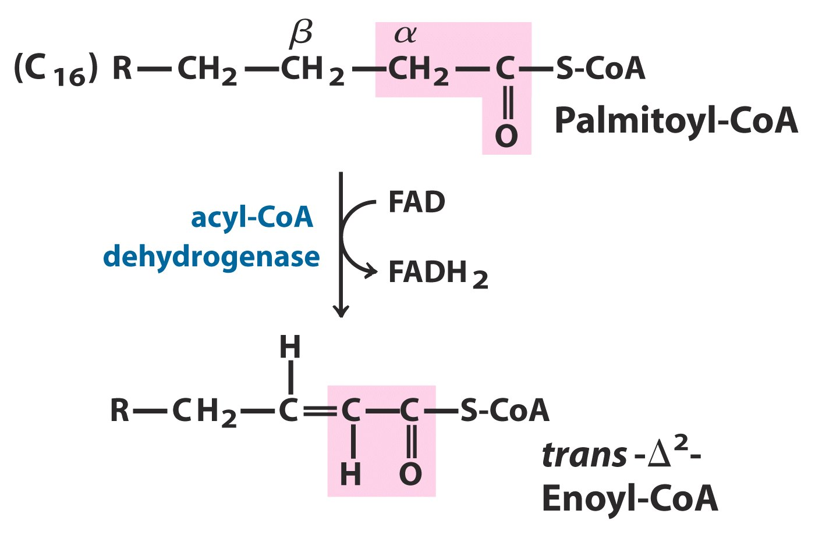

Slide 58
Step I: Oxidation by
FAD linked Acyl CoA Dehydrogenase
Step II: Hydration by Enoyl CoA Hydratase
Step III: Oxidation by NAD linked
βeta Hydroxy Acyl CoA Dehydrogenase
Step IV: Thiolytic Cleavage by Keto Thiolase

Slide 59
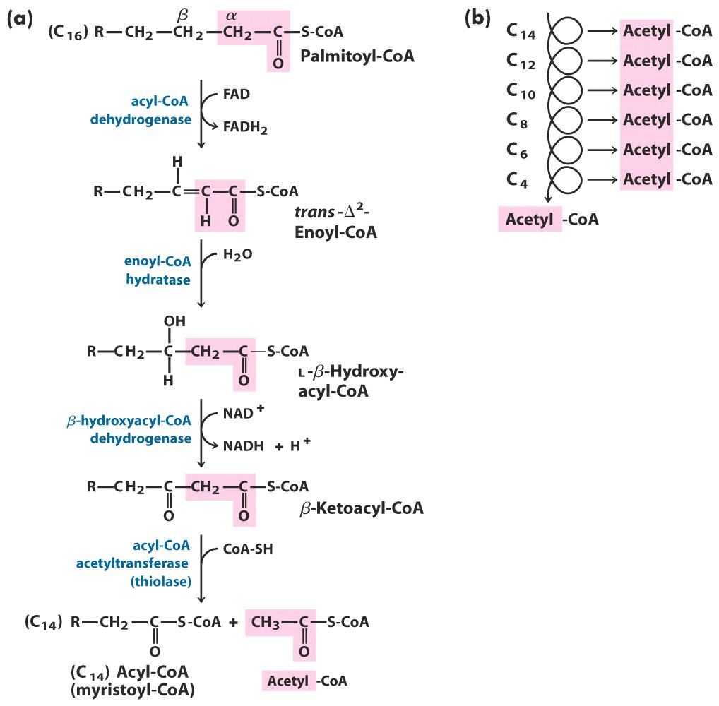

Slide 60
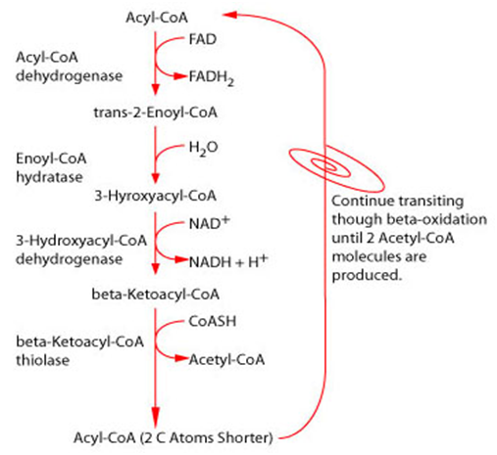

Slide 61
Palmitoylcarnitine
inner mitochondrial
membrane
Carnitine
translocase
respiratory chain
Palmitoylcarnitine
matrix side
1.5 ATP
2.5 ATP
Palmitoyl-CoA
FAD
oxidation
FADH₂
β-Oxidation of Palmitoyl CoA
hydration
H₂O
recycle
6 times
NAD⁺
oxidation
NADH
cleavage
CoA
CH₃-(CH)₁₂-C-S-CoA
+ Acetyl CoA
Citric
acid
cycle
O
2 CO₂

Slide 62
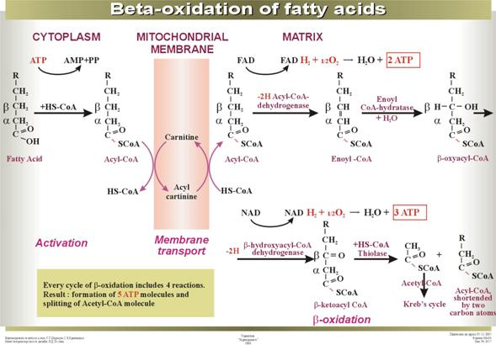

Slide 63
Strategy of First 3 reactions of Beta Oxidation proper is to
Create a Carbonyl group (C=O) on β-Carbon atom (CH2) of a Fatty acid.
This weakens bond between α and β Carbon atoms of Fatty acid.
Notes:
8

Slide 64
Fourth reaction cleaves "β-Keto ester" in a reverse Claisen condensation reaction.

Slide 65
Products of Each turn/cycle of beta oxidation proper are :
Acetyl-CoA
Acyl-CoA with two carbons shorter

Slide 66
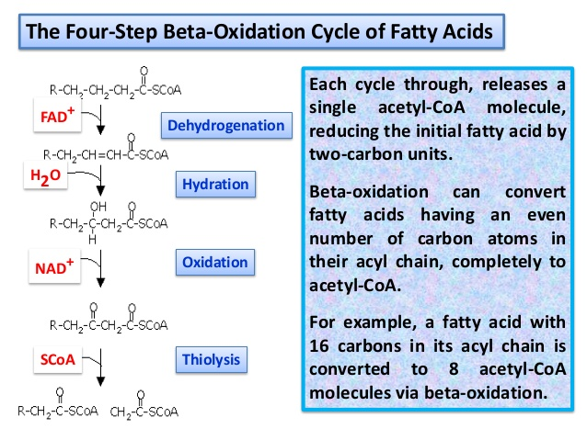

Slide 67
Step 1 Role Of Acyl-CoA Dehydrogenase
To Bring
Oxidation of the C_{α}-C_{β} bond
of Fatty acid
Notes:
9

Slide 68
Acyl CoA Dehydrogenase is a FAD linked Enzyme (Flavoprotein)

Slide 69
Acyl CoA Dehydrogenase catalyzes Oxidation reaction
Where there is a removal of Hydrogen from alpha and beta carbon atoms of Acyl-CoA.

Slide 70
There forms a double bond between C α-C β / C2 and C3 of Fatty Acid.
The product of this oxidation reaction is α-β Unsaturated Acyl CoA /Trans Enoyl CoA.

Slide 71
Coenzyme FAD is the temporary hydrogen acceptor in this oxidation reaction .
The reduced FADH2 is generated by oxidation reaction of Acyl CoA Dehydrogenase.
FADH2 is then reoxidized, after its enter into Electron Transport Chain

Slide 72
Mechanism of Acyl CoA Dehydrogenase involves :
Proton Abstraction/Removes Hydrogen
Double bond formation
Hydride removal by FAD
Generation of reduced FADH2

Slide 73
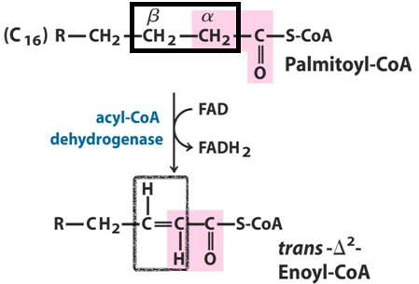

Slide 74
FADH2 is oxidized by entering into ETC.
Electrons from FADH2 are passed to Electron transport chain components,
Coupled with phosphorylation to generate 1.5 ATP
(By Oxidative Phosphorylation).

Slide 76
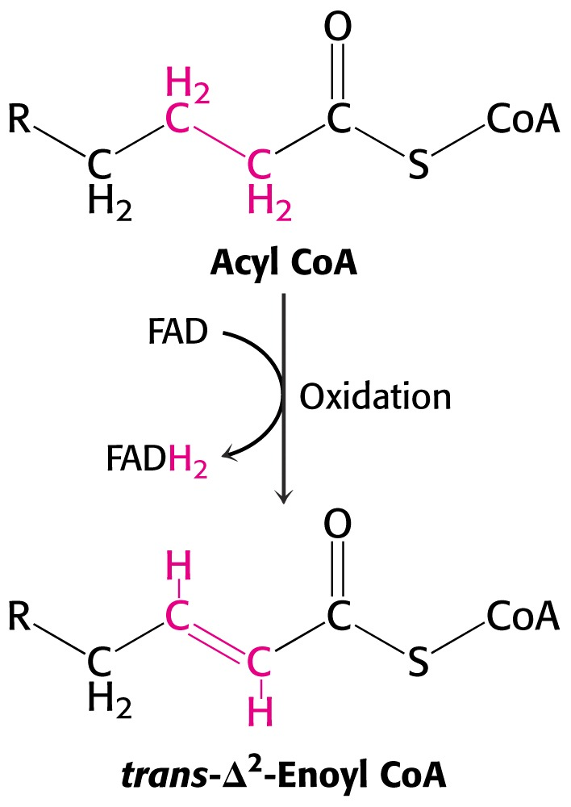

Slide 77
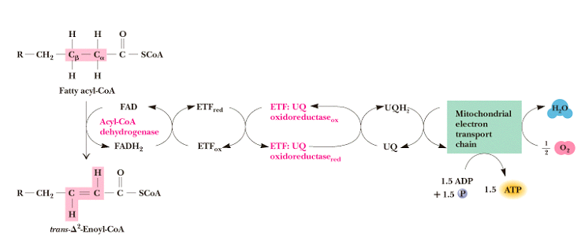
Acyl-CoA Dehydrogenase

Slide 78
There are different Acyl-CoA Dehydrogenases :
Short Chain Fatty acids (4-6 C),
Medium Chain Fatty Acids (6-10 C),
Long (12-18 C) and very long (22 and more)chain Fatty acids.

Slide 79
Inhibitor Of Acyl CoA Dehydrogenase
Acyl CoA Dehydrogenase is inhibited by a Hypoglycin (from Akee fruit)

Slide 80
Step 2 Role Of Enoyl CoA Hydratase
To add water across the double bond
Cα = Cβ of Trans-Enoyl-CoA
Saturate the double bond of Enoyl-CoA
Generate Hydroxyl group at beta carbon
Notes:
9

Slide 81
Enoyl-CoA Hydratase catalyzes stereospecific hydration of the trans double bond
It adds water across the double bond at C2 and C3 of Trans Enoyl CoA

Slide 82
This hydration reaction generates Hydroxyl (OH) group at beta carbon atom of FA
Converts Trans-Enoyl-CoA to
L β-Hydroxyacyl-CoA

Slide 84
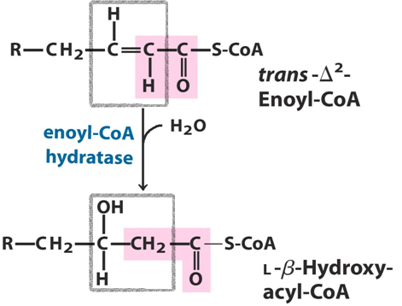

Slide 85
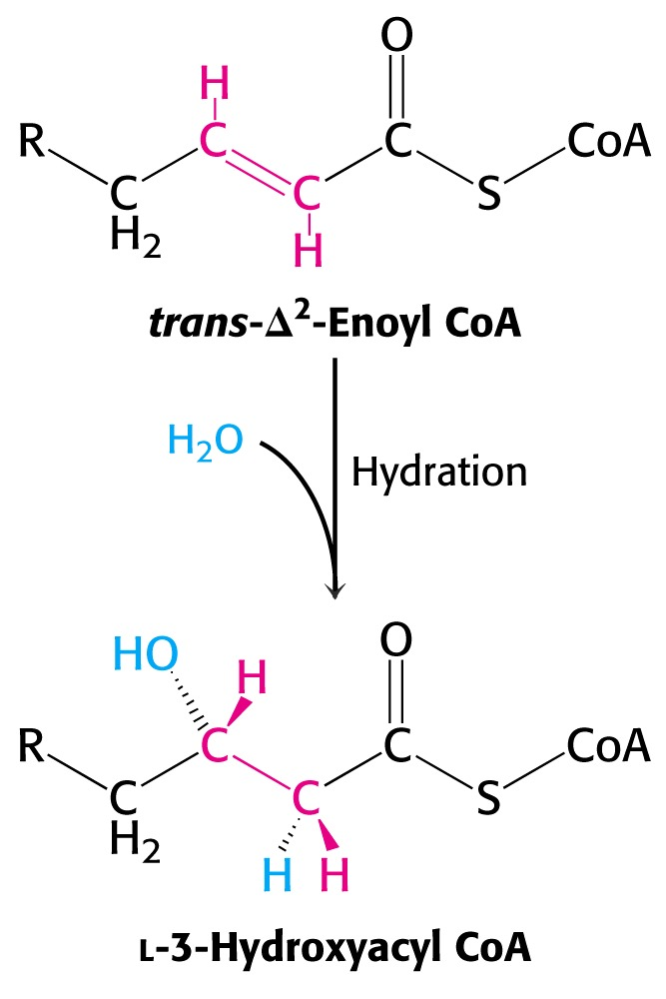

Slide 86
Step 3 Role Of Hydroxyacyl-CoA Dehydrogenase
To Oxidizes the β-Hydroxyl Group of
β-Hydroxyacyl-CoA
And
Transform it into
β-Ketoacyl-CoA
Notes:
11

Slide 87
β-Hydroxyacyl-CoA Dehydrogenase is NAD⁺ dependent
It catalyzes specific oxidation of the Hydroxyl group in the β position (C3) to form a ketone group.
NAD⁺ is the temporary electron acceptor for this step which generates reduced form NADH+H⁺

Slide 88
The oxidation of
β-Hydroxyacyl CoA produces a product β- Ketoacyl-CoA.

Slide 89
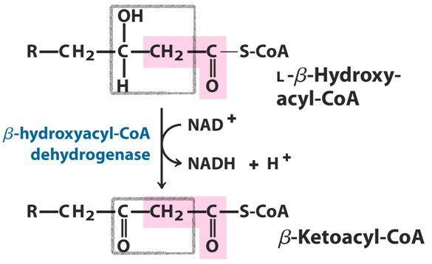

Slide 90
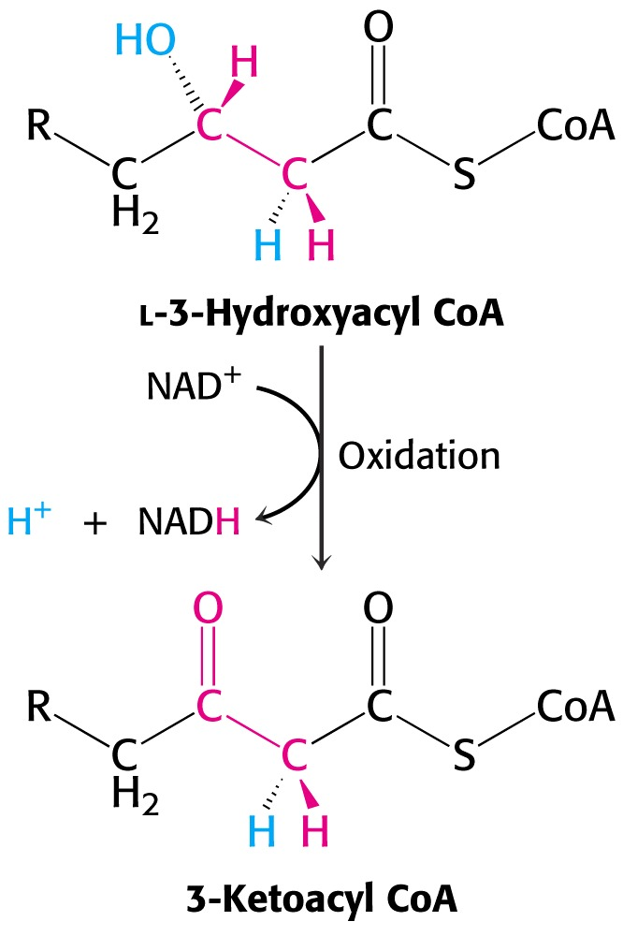

Slide 91
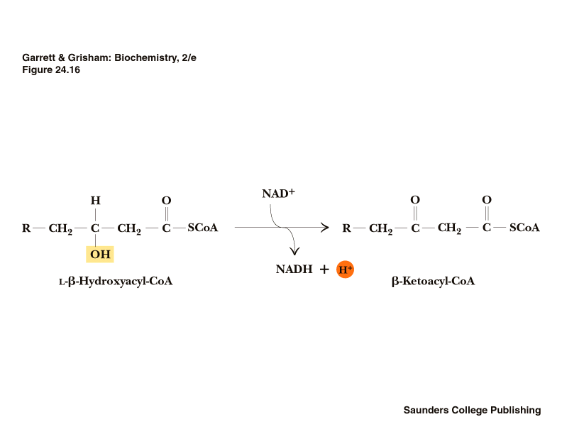

Slide 92
Step 4 Role Of β- Ketothiolase /Thiolase
Catalyzes Thiolytic cleavage of the
two carbon fragment
by splitting the
bond between α and β carbons

Slide 93
An enzyme β−Keto Thiolase attacks the β-carbonyl group of β-Ketoacyl-CoA.
This results in the cleavage of the
C_{α}-C_{β} bond.
Releases Acetyl-CoA(2C) and an Acyl-CoA (-2carbons shorter ).
Notes:
12

Slide 94
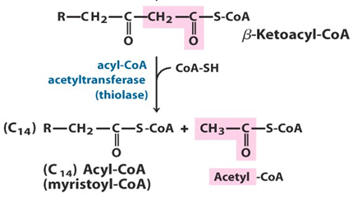

Slide 95
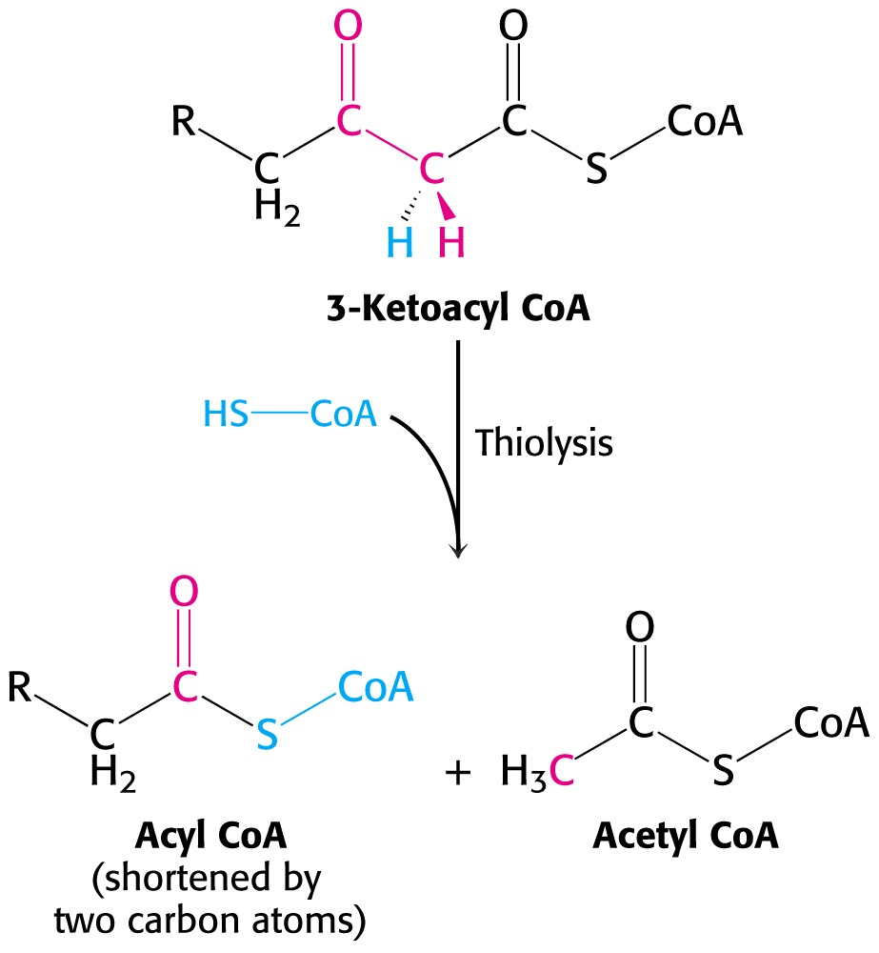

Slide 97
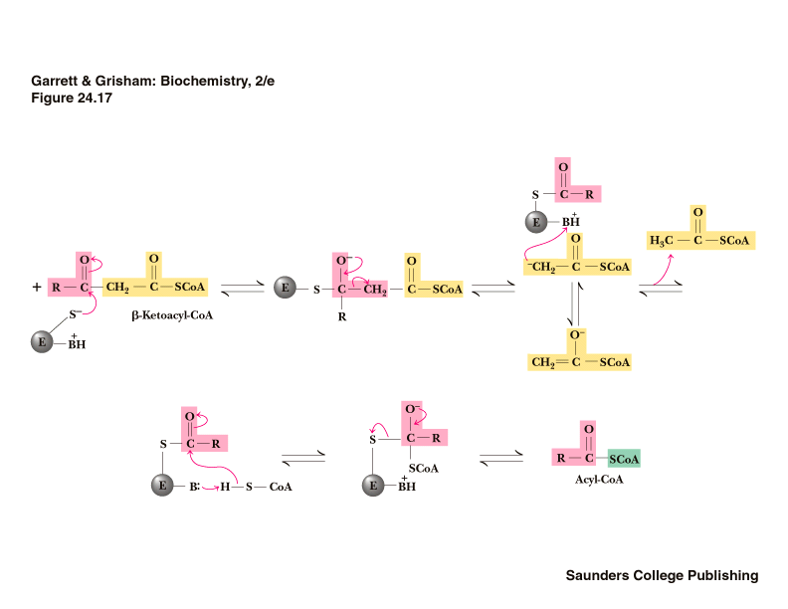

Slide 99
Repetitions Of 4 Steps Of Beta Oxidation Proper
The β-oxidation proper pathway is cyclic.
4 Steps of Beta Oxidation proper are repeated
Till whole chain of Fatty acid is oxidized completely.

Slide 100
Product, 2 carbons shorter Acyl -CoA,
Is input to another round/turn of the beta oxidation proper pathway.

Slide 101
Acyl CoA molecule released at end of Beta Oxidation
Is the substrate for the next round of oxidation starting with Acyl CoA Dehydrogenase.
Repetition continues until all the carbon atoms of the original Fatty acyl CoA are converted to Acetyl CoA.

Slide 102
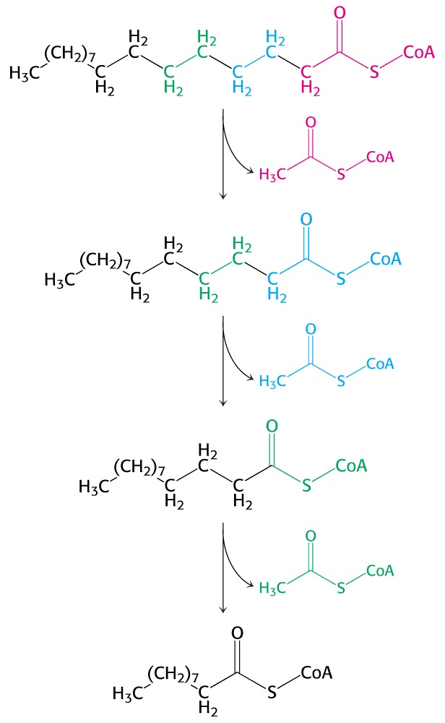
The shortened Acyl CoA then undergoes another cycle of beta oxidation
The number of beta oxidation cycles:
n/2-1, where n – the number of carbon atoms
Notes:
102

Slide 103
Products Of Each Turn Of Beta Oxidation Proper

Slide 104
Each turn/cycle of β oxidation proper generates one molecule each of:
FADH₂
NADH+H⁺
Acetyl CoA
Fatty Acyl CoA ( with 2 carbons shorter each round)

Slide 105
Steps Of β-Oxidation Proper of Fatty Acids Continues With A Repeated Sequence of 4 Reactions Till A Long Fatty Acyl Chain Is Completely Oxidized

Slide 106
For an oxidation of Palmitic acid through beta oxidation
7 turns/cycles of beta oxidation proper steps occur.

Slide 107
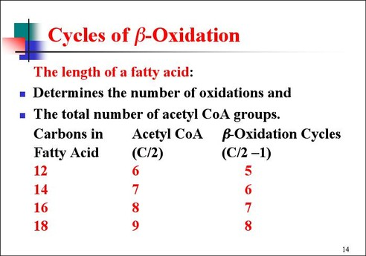
Beta Oxidation

Slide 108
Fates of the products of β-oxidation of Fatty Acid

Slide 109
NADH+H⁺ and FADH₂ - are reoxidized in ETC to generate ATP
Acetyl CoA - Enters the Citric acid cycle(TCA cycle) for its complete oxidation.
Acyl CoA – Undergoes the next turn/cycle of β oxidation proper.

Slide 110
Complete Oxidation Of Fatty Acids

Slide 111
Fatty Acid
β Oxidation
Acetyl CoA +ATP
TCA Cycle
CO2 +H2O and ATP

Slide 112
Fatty acid is activated and oxidized via Beta Oxidation in specific number of cycles depending upon chain length.
Acetyl CoA an end product of Beta oxidation of Fatty acid
Is further completely oxidized via TCA cycle.

Slide 113
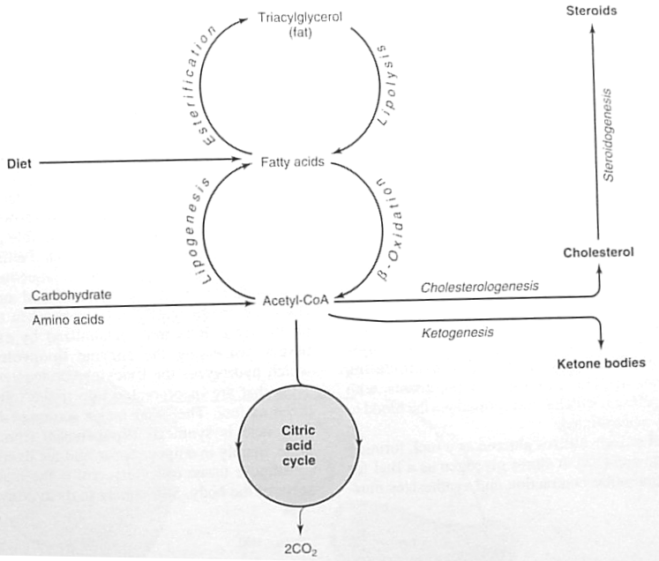
1

Slide 114
Palmitoylcarnitine
inner mitochondrial
membrane
Carnitine
translocase
respiratory chain
Palmitoylcarnitine
matrix side
1.5 ATP
2.5 ATP
Palmitoyl-CoA
FAD
oxidation
FADH₂
Figure 4. Processing and
β-oxidation of Palmitoyl CoA
hydration
H₂O
recycle
6 times
NAD⁺
oxidation
NADH
cleavage
CoA
CH₃-(CH)₁₂-C-S-CoA
+ Acetyl CoA
Citric
acid
cycle
O
2 CO₂

Slide 115
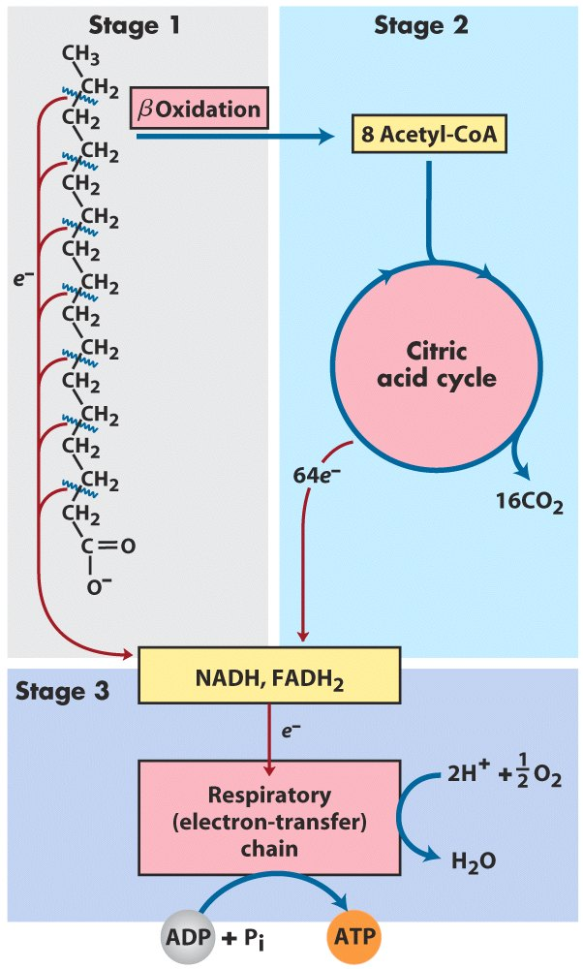
Β-Oxidation Overall Flow
Notes:
Stage one is β-oxidation breaking palmitic acid (here) to acetyl-S-CoA and NADH and FADH₂. Each acetyl-S-CoA can enter the CAC to produce more NADH and FADH₂. All the NADH and FADH₂ produced is then oxidized by the respiratory electron transport to generate the proton motive force that produces ATP. As you can see in Stage 1 each round of β-oxidation produces one acetyl-S-CoA and leaves the fatty-acyl-S-CoA two carbons shorter…see next slide.

Slide 116
CAPILLARY
Lipoproteins
(Chylomicrons
or VLDL)
L
[2]
FABP
MITOCHONDRION
P
L
FA
acetyl-CoA
TCA
A
cycle
[7]
[3]
[4]
C
FA
β-oxidation
FA
S
[6]
albumin
FA
FA
acyl-CoA
acyl-CoA
FABP
FABP
[5]
FA
carnitine
transporter
CYTOPLASM
[1]
from
fat
cell
cell membrane
FA = fatty acid
LPL = lipoprotein lipase
FABP = fatty acid binding protein
ACS = acyl CoA synthetase
Figure 2. Overview of fatty acid degradation

Slide 117
Energetics Of Beta oxidation Of Palmitate

Slide 118
Oxidation of Palmitic Acid C16 Number of turns of fatty acid spiral = 8-1 = 7 Cycles of beta oxidation proper.
Generates 8 Acetyl CoA

Slide 119
During Electron Transport and Oxidative Phosphorylation Each FADH2 yield 1.5 ATP and NADH 2.5 ATP

Slide 120
Energetics of Fatty Acid Beta Oxidation
e.g. Palmitic (16C):
β-oxidation of Palmitic acid will be repeated in 7 cycles producing 8 molecules of Acetyl COA.
In each cycle 1 FADH2 and 1 NADH+H⁺ is produced and will be transported to the respiratory chain/ETC.
FADH₂ 1.5 ATP
NADH + H⁺ 2.5 ATP
Thus Each cycle of β-oxidation 04 ATP
So 7 cycles of β-oxidation 4 x 7 = 28 ATP

Slide 121
1 Acetyl CoA Yields 10 ATPs via TCA Cycle

Slide 122
Review ATP Generation –TCA/ Citric Acid Cycle which start with Acetyl CoA
Step ATP produced
Step 4 (NADH+H to ETC) 2.5 ATP
Step 6 (NADH+H to E.T.C.) 2.5 ATP
Step 10 (NADH+H to ETC) 2.5 ATP
Step 8 (FADH2 to E.T.C.) 1.5 ATP
1 GTP 01 ATP
NET per turn of TCA Cycle 10 ATP

Slide 123
1 ATP converted to AMP during activation of Palmitic acid to Palmitoyl-CoA is equivalent to 2ATPs utilized

Slide 124
Each Acetyl COA which is oxidized completely in citric cycle/TCA cycle gives 10 ATP
Hence 8 Acetyl CoA via TCA cycle (8 x 10 = 80 ATP)
2 ATP are utilized in the activation of Fatty acid
Energy gain = Energy produced - Energy utilized
28 ATP + 80 ATP - 2 ATP = 106 ATP

Slide 125
Thus On Complete Oxidation of One molecule of Palmitate 106 molecules of ATP are generated

Slide 126
ATP Generation from Palmitate Oxidation
Net yield of ATP per one oxidized Palmitate
Palmitate (C₁₅H₃₁COOH) - 7 cycles – n/2-1
Palmitoyl CoA + 7 HS-CoA + 7 FAD⁺ + 7 NAD⁺ + 7 H₂O
8 Acetyl CoA + 7FADH₂ + 7 NADH + 7 H⁺
Notes:
126

Slide 127
ATP generated
8 Acetyl CoA(TCA) 10x8=80 7 FADH₂ 7x1.5=10.5
7 NADH 7x2.5=17.5 108 ATP
ATP expended to activate Palmitate -2 ATP
Net yield of ATPs with Palmitate Oxidation: 106 ATP

Slide 128
Total End Products Of Beta Oxidation Of 1 molecule of a Palmitic Acid

Slide 129
Palmitic acid With 7 Turns of Beta Oxidation Proper Generates 8 Molecules Of Acetyl-CoA 7 FADH2+7 NADH+H⁺

Slide 130
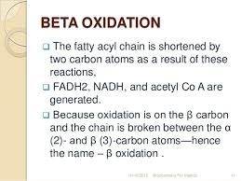

Slide 131
Summary of one round/turn/cycle of the
β-oxidation pathway:
Fatty Acyl-CoA + FAD + NAD⁺ + HS-CoA
+Acetyl-CoA
Fatty Acyl-CoA (2 C less) + FADH₂ + NADH + H⁺

Slide 132
Stoichiometry for Palmitic Acid Oxidation

Slide 133
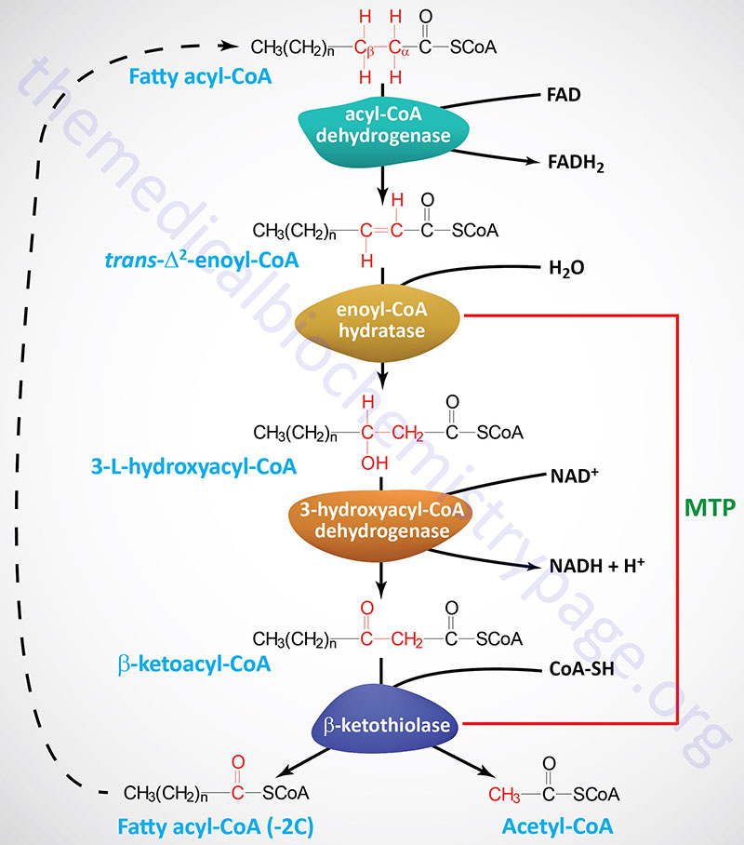

Slide 134
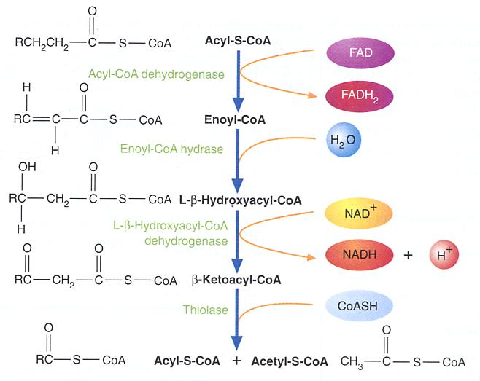
β-Oxidation Proper of Acyl-CoA

Slide 135
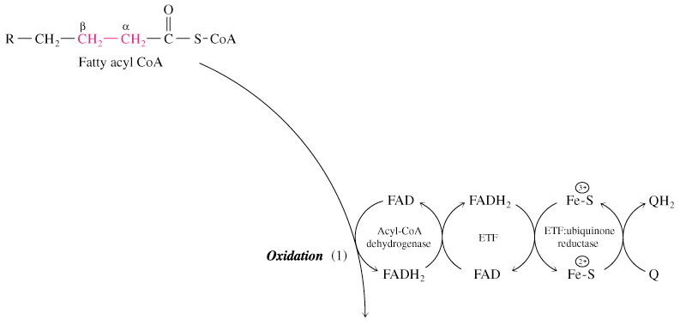
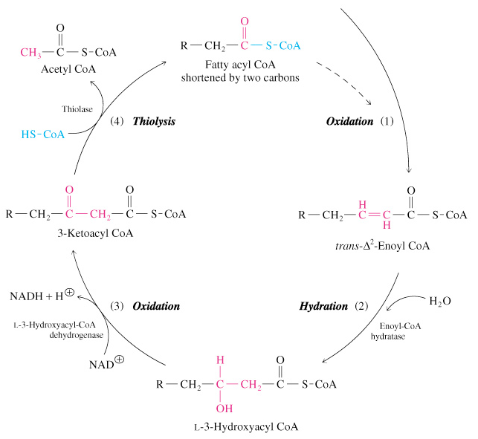
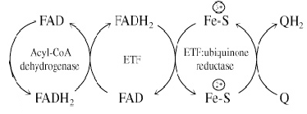
β-Oxidation of Saturated fatty acids
Fatty acyl CoA
Notes:
135

Slide 136
Regulation Of Beta Oxidation Of Fatty Acids

Slide 137
Lipolysis and
β Oxidation of Fatty acids are well regulated under Hormonal influence.

Slide 138
Insulin secretion is In Well Fed Condition
Insulin inhibits Lipolysis of Adipose Fat (TAG) and mobilization of Free Fatty acids.
Insulin decreases β Oxidation of Fatty acids.

Slide 139
Glucagon In Emergency Condition
When Cellular or Blood Glucose lowers down there is secretion of Glucagon.
Glucagon and Epinephrine stimulates Lipolysis in emergency condition.

Slide 140
Glucagon stimulates the Enzyme Hormone sensitive Lipase and hydrolyzes depot Fat(TAG).
Glucagon mobilizes Free fatty acids out into blood circulation
Increases β Oxidation of Fatty acids.

Slide 141
Regulation Of Beta Oxidation Of Fatty Acid At Two Levels
Carnitine Shuttle
Beta Oxidation Proper

Slide 142
Transport of Fatty Acyl CoA from Cytosol into Via Carnitine Shuttle Mitochondrial Matrix Is a Rate-limiting step

Slide 143
Malonyl-CoA Regulates Beta Oxidation At Carnitine Transport Level Malonyl-CoA an intermediate of Lipogenesis Is an Inhibitor of Carnitine Acyl Transferase I

Slide 144
Malonyl-CoA is produced from Acetyl-CoA by the enzyme Acetyl-CoA Carboxylase during Fatty acid biosynthesis.
Malonyl-CoA (which is a precursor for fatty acid synthesis) inhibits Carnitine Palmitoyl Transferase I.
This Control of Fatty acid oxidation is exerted mainly at the step of Fatty acid entry into mitochondria.

Slide 145
Acyl-CoA Dehydrogenase is Regulatory or Key Enzyme of Beta Oxidation Of Fatty Acids

Slide 146
Significance Of Beta oxidation of a Fatty acid

Slide 147
Beta oxidation cycles helps in cleaving and shortening of a long chain Fatty acid

Slide 148
Oxidation of Beta carbon atom of a Fatty acid transforms stronger bond between alpha and beta carbon atom to a weaker bond.

Slide 149
Transformation to a weaker bond helps in easy cleavage between alpha and beta carbon
During β oxidation there is dehydrogenation of beta carbon atom (CH2 to C=O)

Slide 150
Hydrogen atoms removed during beta oxidation are
Temporarily accepted by the oxidized coenzymes (FAD and NAD⁺) to form reduced coenzymes
Reduced coenzymes then finally enter ETC and get reoxidized
The byproduct of ETC is ATP

Slide 151
Thus Beta oxidation of Fatty acid
Metabolizes a long chain fatty acid with liberation of chemical form of energy ATP for cellular activities.

Slide 152
Summary of β-Oxidation
Repetition of the β-Oxidation Cycle yields a succession of Acetate units
Palmitic acid yields eight Acetyl-CoAs
Complete β-oxidation of one Palmitic acid yields 106 molecules of ATP
Large energy yield is consequence of the highly reduced state of the carbon in fatty acids
This makes fatty acid the fuel of choice for migratory birds and many other animals
Notes:
13

Slide 153
Disorders OF Beta Oxidation Of Fatty Acids

Slide 154
Deficiencies of Carnitine OR Carnitine Transferase OR Translocase Activity Are Related to Disease State

Slide 155
Biochemical Consequences of Carnitine Shuttle Defect
Defect in Carnitine shuttle system
No Beta Oxidation of Fatty acids
No ATP generation
All ATP dependent processes will be ceased
Cell deaths
Organ failures

Slide 156
Carnitine Shuttle Defects
Affects normal function of Muscles, Kidney, and Heart.

Slide 157
Symptoms include Muscle cramping, during exercise, severe weakness and death.
Muscle weakness occurs since they are related with Fatty acid oxidation for long term energy source.

Slide 158
Management Of Individuals with Carnitine Shuttle Defects
Note people with the Carnitine Transporter Defect
Should be supplemented with a diet with medium chain fatty acids
Since MCFAs do not require Carnitine shuttle to enter Mitochondria.

Slide 159
Sudden Infant Death Syndrome (SIDS)

Slide 160
SIDS
SIDS is a congenital rare disorder with an incidence of 1 in 10,000 births.
Biochemical Defect: Due to congenital defect of Enzyme Acyl-CoA Dehydrogenase a regulatory enzyme of β Oxidation of Fatty acid.

Slide 161
Biochemical Consequences Of SIDS
Deficiency of Acyl-CoA Dehydrogenase
Blocks β Oxidation of Fatty acid.
Stops liberation and supply of energy in form of ATPs in fasting condition
Leads to unexpected death of an infant.

Slide 162
Symptoms in defective Beta Oxidation of Fatty acids include:
Hypoglycemia
Low Ketone body production during fasting
Fatty Liver
Heart and/or Skeletal muscle defects
Complications of pregnancy
Sudden infant death (SID).

Slide 163
Hereditary deficiency of Medium Chain Acyl-CoA Dehydrogenase (MCAD)
Most common genetic disease relating to fatty acid catabolism, has been linked to SIDS.

Slide 164
Jamaican Vomiting Sickness

Slide 165
Jamaican Vomiting Syndrome is due to ingestion of unripe Ackee fruit by people in Jamaica
(Jamaica-Country of Caribbean)

Slide 166

Ackee Fruit

Slide 167
Ackee fruit is rich in Hypoglycin –A
Hypoglycin is an inhibitor of regulatory Enzyme β Oxidation Proper Acyl-CoA Dehydrogenase.

Slide 168
Jamaican Vomiting Disease leads to complications characterized by :
Severe Vomiting (throwing out)
Hypoglycemia
Water Electrolyte Imbalance
Convulsions
Coma
Death

Slide 169
Beta Oxidation Of Odd Chain Saturated Fatty Acids

Slide 170
Ingestion of Odd chain carbon Fatty acids are less common in human body.
Odd chain Fatty acids are formed by some bacteria in the stomachs of ruminants and the human colon.

Slide 171
β-oxidation of odd chain Saturated Fatty acid occurs same as even chain Fatty acid oxidation
Releasing Acetyl CoA (2C) in every turn.
Until the final Thiolase cleavage
Which results in a 3 Carbon Acyl-CoA /Propionyl-CoA in last cycle and last step of beta oxidation.

Slide 172
End Products Of Odd Chain Fatty Acid Oxidation

Slide 173
End products of β-oxidation of an odd-number Fatty acid is :
Acetyl-CoA(C2)
Propionyl-CoA(C3)

Slide 174
Fate Of Acetyl-CoA
Acetyl CoA released from beta oxidation of odd chain fatty acid
Enter in TCA cycle and get completely oxidized.

Slide 175
Fate Of Propionyl-CoA OR Metabolism Of Propionyl CoA

Slide 176
Propionyl CoA (3C) An End Product Of Odd Chain Fatty Acid Is Converted into Succinyl CoA (4C) A TCA intermediate

Slide 177
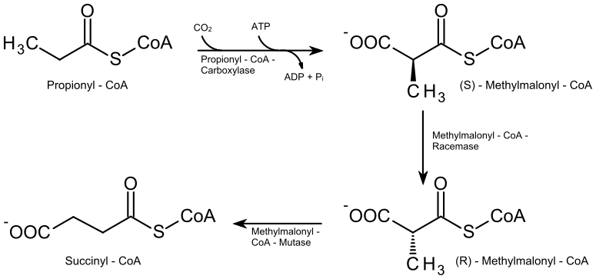
Metabolism Of Propionyl-CoA

Slide 178
Metabolism of Propionyl-CoA
The Propionyl-CoA is converted to Succinyl-CoA.
Which is an intermediate of TCA/Citric acid cycle
Notes:
14

Slide 179
Propionyl CoA metabolism is dependent on Two Vitamin B complex members:
Biotin
Vitamin B₁₂

Slide 180
Special set of 3 Enzymes are required to further metabolize Propionyl-CoA to Succinyl -CoA.
Final Product Succinyl-CoA enters TCA cycle and get metabolized.

Slide 181
Three Enzymes convert Propionyl-CoA to Succinyl-CoA:
Carboxylase
Epimerase
Mutase

Slide 182
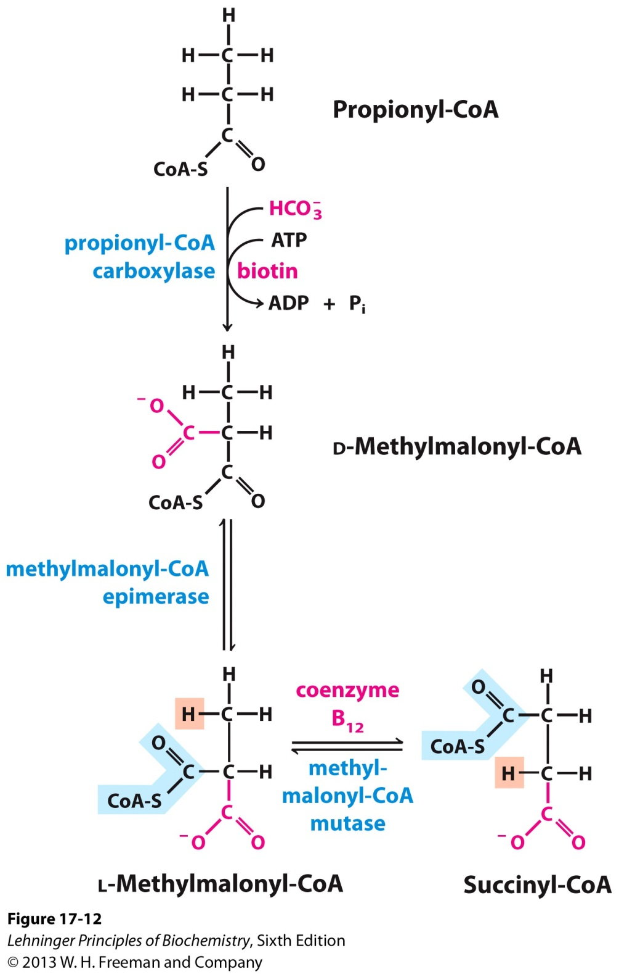

Slide 183
Step1
Propionyl CoA is Carboxylated to yield
D Methylmalonyl CoA.
Enzyme: Propionyl CoA Carboxylase
Coenzyme: Cyto Biotin
An ATP is required

Slide 184
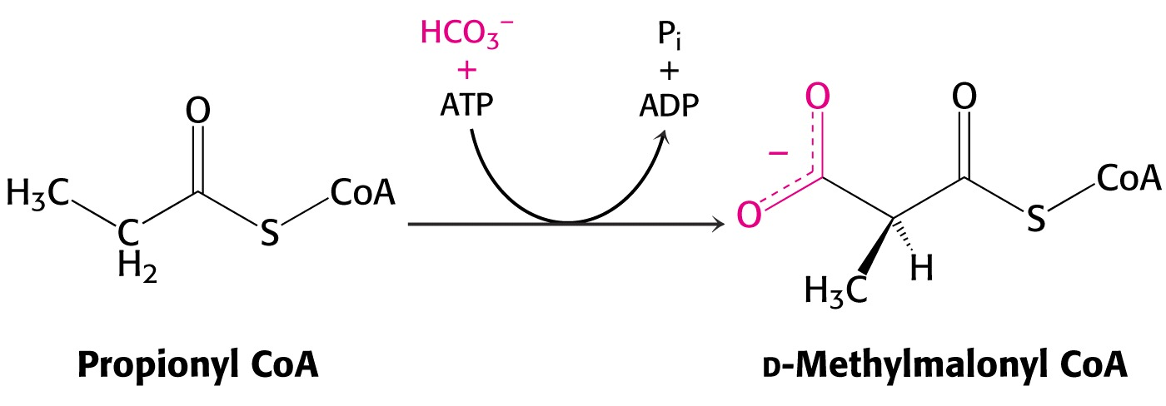
Notes:
184

Slide 185
Step2
The D Methylmalonyl CoA
is racemized to the
L Methylmalonyl CoA.
Enzyme: Methylmalonyl-CoA Racemase/ Epimerase

Slide 186
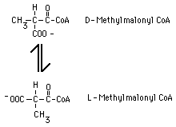

Slide 187
Step 3
L Methylmalonyl CoA is converted into Succinyl CoA by an intramolecular rearrangement
Enzyme: Methylmalonyl CoA Mutase
Coenzyme of Vitamin B12 :Deoxy Adenosyl Cobalamin

Slide 188
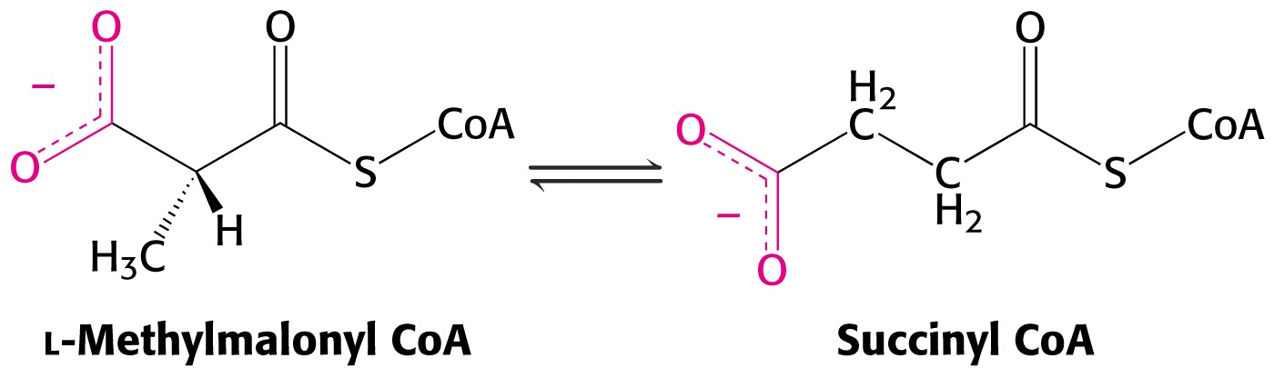
Notes:
188

Slide 189
Fates Of Succinyl CoA
Succinyl CoA
Enters TCA cycle and get metabolized
Serve as Glucogenic precursor for Glucose biosynthesis in emergency condition
Used as a precursor for Heme biosynthesis
Involves in Thiophorase reaction of Ketolysis.

Slide 190
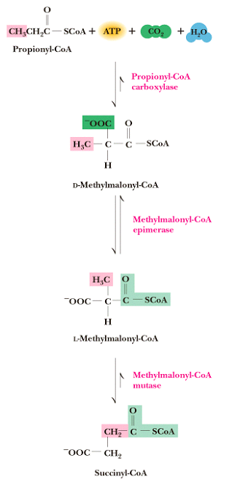

Slide 191
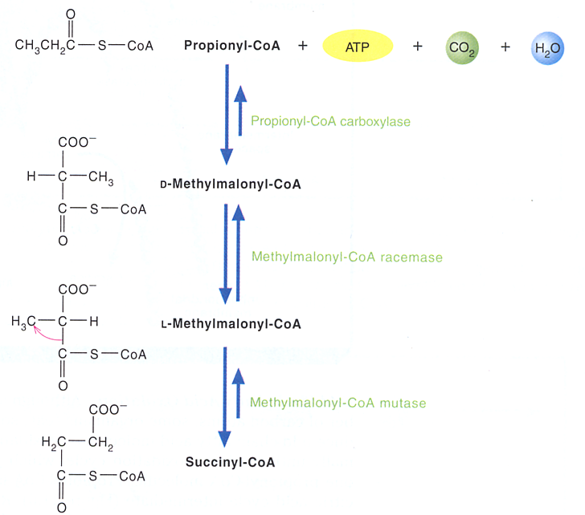
Oxidation of Odd-chain Fatty Acids Conversion of Propionyl-CoA to Succinyl-CoA

Slide 192
Defects In Propionyl CoA Metabolism

Slide 193
Deficiency of Enzyme Propionyl-CoA Carboxylase will block the metabolism of Propionyl-CoA.
Accumulates Propionyl-CoA in blood leading to Propionicacidemia.

Slide 194
Deficiency of Vitamin B Complex members affects Propionyl CoA metabolism to Succinyl –CoA.
Vitamin B12 deficiency blocks the Mutase reaction
Accumulates L-Methyl Malonyl-CoA leading to Methyl Malonylaciduria.

Slide 195
Alpha Oxidation Of Fatty Acid OR Oxidation Of Branched-Chain Fatty Acid OR Phytanic Acid Oxidation 3,7,11,15-tetramethyl Hexadecanoic acid

Slide 196
Source of Phytanic acid in human body is through ingestion of animal Foods.
Phytanic acid is a breakdown product of Phytol component of plant chlorophyll.

Slide 197
Why Phytanic Acid Does Not Initiate With Beta Oxidation Process?

Slide 198
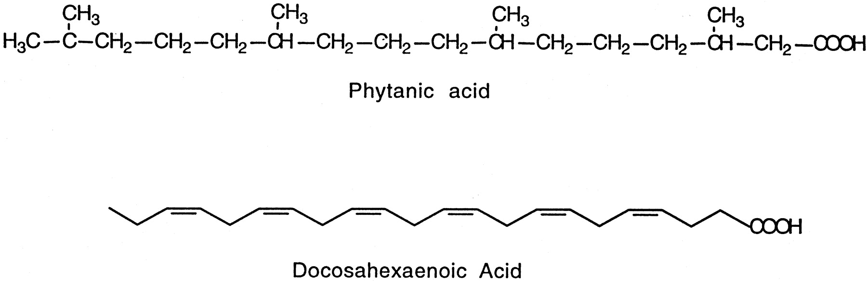
Phytanic acid is a 16 Carbon Branched chain Fatty Acid.
Has Four Methyl branches at odd-number carbons 3,7,11 and 15.
Which is not good substrates for β-oxidation.

Slide 199
Branched chain Phytanic acid contains Methyl (CH3) group at β Carbon atom.
Hence it cannot get oxidized initially via β oxidation pathway

Slide 200
In α Oxidation of Phytanic acid Alpha Carbon atom is oxidized
With the release of one Carbon unit CO2 at one time.

Slide 201
Thus initially Phytanic acid follows α Oxidation
Modify Phytanic acid to Pristanic acid and
Further present it for Beta Oxidation process.

Slide 202
Occurrence Of Alpha Oxidation Of Phytanic Acid

Slide 203
Predominantly Alpha Oxidation Of Phytanic Acid Takes Place in Endoplasmic Reticulum of Brain Cells Also In Peroxisomes

Slide 204
Mechanism Of Alpha Oxidation Of Phytanic Acid

Slide 205
Phytanic acid 3,7,11,15-Tetramethyl Hexadecanoic acid
Alpha oxidation removes Methyl groups at beta carbon.
Later making Fatty acid ready for beta oxidation process.

Slide 206
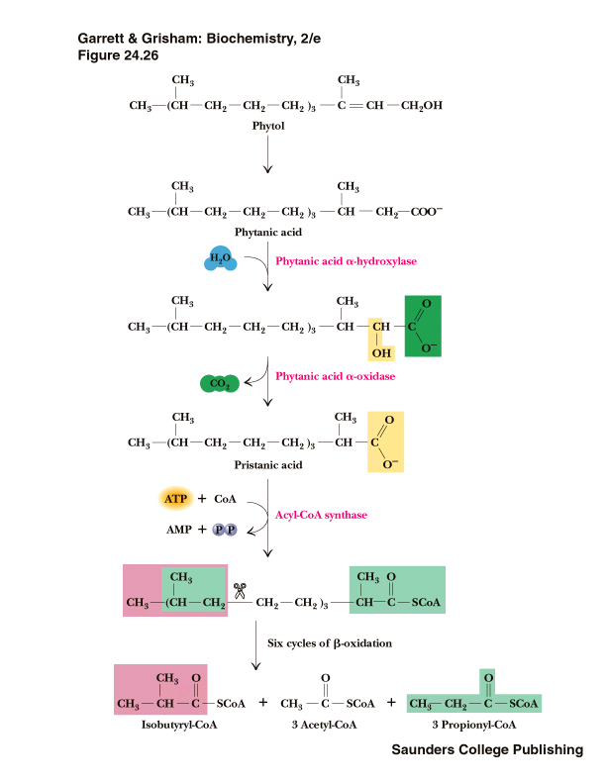

Slide 207
During α Oxidation there occurs:
Hydroxylation at α Carbon in presence of Enzyme Hydroxylase or Monoxygenase .
This reaction is Vitamin C dependent forming α Hydroxy Acyl-CoA.

Slide 208
α Hydroxy Acyl-CoA is then oxidized to α Keto Acyl-CoA.
Ketonic group at α Carbon atom is decarboxylated
Yielding CO2 molecule and a Fatty acid with one Carbon atom less.

Slide 209
Phytanic acid on alpha oxidation is converted to Pristanic acid
Which is further metabolized via beta oxidation process to generate Propionyl-CoA.

Slide 210
Products of Phytanic Acid Oxidation
Alpha oxidation of Phytanic acid Generates
Acetyl-CoA
Propionyl-CoA
Isobutryl-CoA

Slide 211
Disorders Associated With Defective α Oxidation Of Phytanic Acid

Slide 212
Refsums Disease

Slide 213
Refsums disease is a rare but severe neurological disorder.
Caused due to defect in α Oxidation of Phytanic acid

Slide 214
The Enzyme Defects
Deficiency of Enzyme Phytanic acid α Oxidase/ Phytanol-CoA Dioxygenase leads to Refsum's disease.
Autosomal Recessive

Slide 215
Biochemical Consequence Of Refsums disease Is:
No Oxidation of Phytanic acid
Accumulation of Phytanic acid in Brain cells and Other Tissues
Dysfunction of Brain
Manifesting Neurological disorder

Slide 216
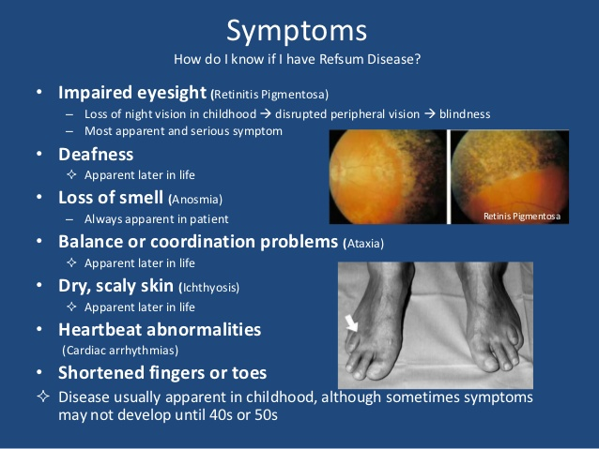

Slide 217
Management Of Refsums disease is :
Avoid eating diet containing Phytol /Phytanic acid.

Slide 218
Omega Oxidation Of Fatty Acids

Slide 219
Omega Oxidation of Fatty acid is:
Oxidation of Omega Carbon atom (CH3) of a Fatty acid.

Slide 220
When Does Omega Oxidation Of Fatty Acid Occurs?

Slide 221
Omega Oxidation takes place when there is defect in β Oxidation of fatty acid.

Slide 222
During ω Oxidation of Fatty acid
ω Carbon atom (CH3) of a Fatty acid is transformed to -COOH

Slide 223
Omega oxidation forms Dicarboxylic acid
Which further undergo oxidation
Form more short Dicarboxylic acids Adipic acid and Succinic acid
Which are more polar excreted out in Urine.

Slide 224
ω-Oxidation of Fatty acids Occur in Endoplasmic Reticulum of Liver Cells

Slide 225
Mechanism Of ω Oxidation
ω Oxidation of Fatty acid is a minor alternative oxidative Pathway.

Slide 226
Omega Oxidation of a Fatty acid takes place with:
Hydroxylation Reaction
Oxidation Reaction

Slide 227
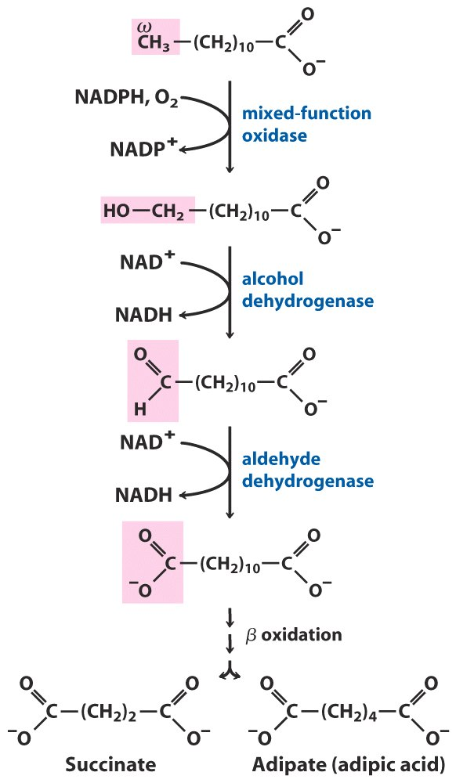
ω = Omega, last letter in Greek alphabet
Notes:
There are two other fatty oxidation pathways. They are there, they are not the major flow.

Slide 228
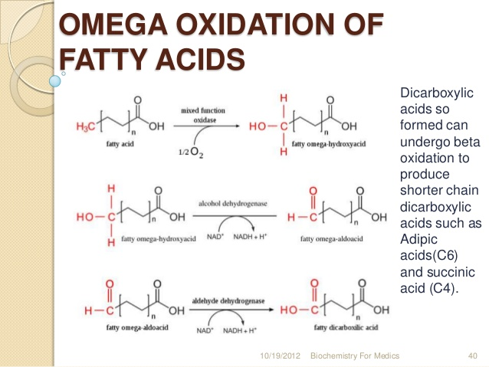

Slide 229
In ω Oxidation of Fatty acid there occurs Hydroxylation at ω Carbon atom
Converting into Primary terminal Alcohol
(-CH2OH) group.
This reaction is catalyzed by NADPH+H⁺ dependent Cytochrome P450 system
Next primary terminal Alcohol group is oxidized to form -COOH group .

Slide 230
Further Dicarboxylic acid generated through Omega Oxidation undergoes beta oxidation
To produce short chain Dicarboxylic acids as Adipic acid and Succinic acid
Which are polar and excreted out through Urine.

Slide 231
Significance Of Omega Oxidation
Omega Oxidation transforms a non polar Fatty acid to polar Dicarboxylic fatty acid.
Omega Oxidation of fatty acid facilitates excretion of accumulated fatty acids due to defective normal β Oxidation in cells.

Slide 232
Peroxisomal Oxidation Of Fatty Acids

Slide 233
OXIDATION OF FATTY ACIDS IN PEROXISOMES
Peroxisomes – Cell organelles containing Enzymes Peroxidase and Catalase
These Enzymes catalyzes dismutation of Hydrogen peroxide into water and molecular oxygen
Notes:
233

Slide 234
When ? Why? How? Does Peroxisomal Oxidation OF Fatty Acid Occurs?

Slide 236
β-Oxidation of very long-chain fatty acids(>C22) occurs within Peroxisomes initially
Later undergoes Mitochondrial β Oxidation .

Slide 237
Carnitine is involved in transfer of Very long Chain Fatty acids (VLCFAS >C22) into and out of Peroxisomes.

Slide 238
Peroxisomal Fatty acid oxidation is induced by a high Fat diet with VLCFAs.
To shortens VLCFAs into LCFAs
Which are further degraded by Beta oxidation process.

Slide 239
Peroxisomal β-Oxidation
Similar to Mitochondrial β-oxidation,
Initial double bond formation is catalyzed by Flavoprotein Acyl-CoA Oxidase
Notes:
17

Slide 240
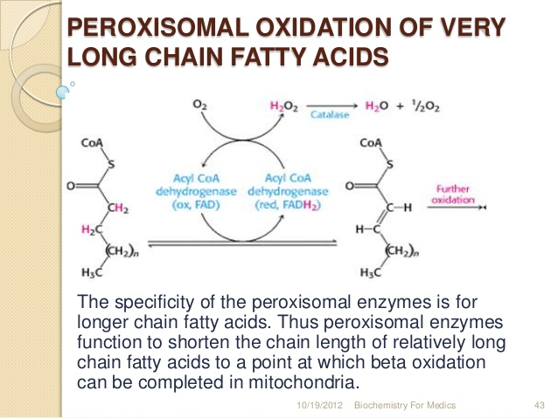

Slide 241
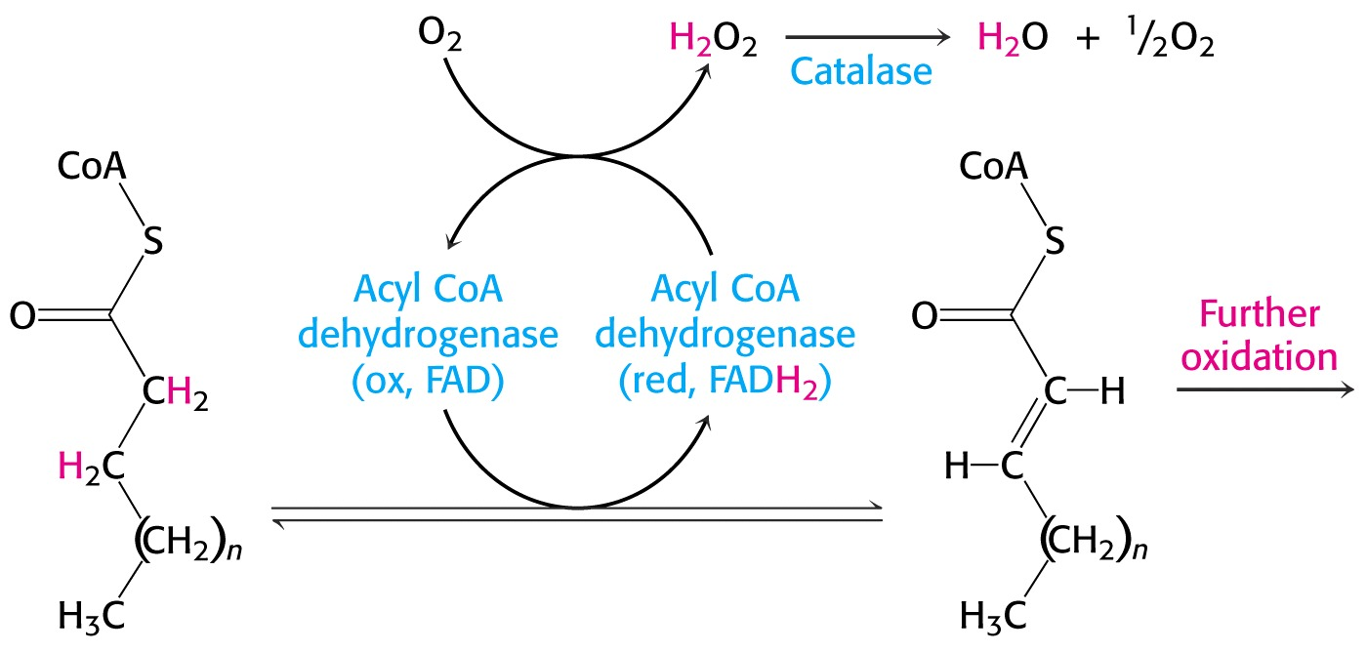
Acyl CoA Oxidase–FAD transfers electrons to O₂ to yield H₂O_{2.}

Slide 242
Coenzyme FAD is e⁻ acceptor for Peroxisomal Acyl-CoA Oxidase, which catalyzes 1st oxidative step of pathway.

Slide 243
FADH2 generated at this step instead of transferring high-energy electrons to ETC, as occurs in Mitochondrial beta-oxidation.
Electrons of FADH2 directly go to O₂ at reaction level to generate H2O2 in Peroxisomes.

Slide 244
Thus FADH2 generated in Peroxisomes by Fatty acid oxidation do not enter ETC to liberate ATPs.
Instead peroxisome, FADH₂ generated by fatty acid oxidation by Acyl CoA Oxidase is reoxidized producing Hydrogen peroxide.

Slide 245
FADH₂ + O₂ → FAD + H₂O₂
Peroxisomal enzyme Catalase degrades H₂O₂:
2 H₂O₂ → 2 H₂O + O₂
These reactions produce No ATP.

Slide 246
Once Very Long Chain Fatty acids are reduced in length within the Peroxisomes
They may shift to Mitochondrial beta oxidation for further catabolism of fatty acids.

Slide 247
No ATPs result from steps of Peroxisomal oxidation of VLCFAs.

Slide 248
Steps of Peroxisomal Oxidation of Fatty acid does not generate ATPs
Instead energy dissipated in form of heat.

Slide 249
Many drugs commercially available in market for reducing obesity
Stimulate Peroxisomal beta oxidation
Where Fatty acids are oxidized without much liberation of calories (ATPs).

Slide 250
Peroxisomal Oxidation of Fatty acid efficiently takes place in:
Obese persons
Persons taking Hypolipidemic drugs(Clofibrate).

Slide 251


Slide 252


Slide 253

Zellwegers Syndrome OR Cerebrohepatorenal Syndrome

Slide 254

Peroxisomal Disorder
Zellweger Syndrome
Cerebro-Hepato-Renal Syndrome

Slide 255
Biochemical Causes

Slide 256
Rare genetic autosomal recessive disorder.
Characterized by absence of functional Peroxisomes.

Slide 257
Gene mutations in PEX Genes leads to Zellwegers Syndrome.

Slide 258
Biochemical Alterations
No oxidation of very long chain Fatty acids and branched chain fatty acids in Peroxisomes

Slide 259
Accumulation of large abnormal amounts of VLCFAs in Peroxisomes of tissues.
No normal function of Peroxisomes.

Slide 260
Progressive degeneration of Brain/Liver/Kidney, with death ~6 month after onset.

Slide 261
Signs and Symptoms
Defect in normal function of multiple organ system.
Impaired neuronal migration, positioning and brain development.
Hypomyelination affecting nerve impulse transmission.
Hepatomegaly
Renal Cysts
Typical Dysmorphic facies.

Slide 262
Diagnosis
Detection of Increased levels of Serum Very Long Chain Fatty Acids- VLCFAs

Slide 263


Slide 264
Oxidation Of Unsaturated Fatty Acids

Slide 265
PUFAs having double bonds in their structure are unstable.
Double bonds are hydrolyzed and metabolized faster than saturated bonds.
Thus dietary intake of PUFA get readily metabolized
Which reduces risk of Atherosclerosis.

Slide 266
PUFAs are less reduced than SFAs
Hence PUFAs are less energetic than SFAs

Slide 267
Mechanism Of Oxidation Of Unsaturated Fatty Acids

Slide 268
Initial and later Oxidation of PUFAs is by
Similar steps of β Oxidation in parts, of saturated bonds.

Slide 269
Double bonds of UFAs are cleaved by action of Extra Enzymes:
Isomerase (Enoyl CoA Isomerase)
(For odd numbered double bonds MUFAs)
Reductase (2,4 Dienoyl CoA Reductase)
(For even numbered double bonds PUFAS)
Epimerase
(Converts D-Isomer to L-Isomer)

Slide 270
Enoyl CoA Isomerase handles odd numbered double bonds in MUFAs.
2,4 Dienoyl CoA Reductase handles even numbered double bonds in PUFAs.

Slide 271
Usually natural unsaturated fatty acids have cis double bonds.
Which is transformed to trans double bonds by the action of an Isomerase .
As next enzyme to act is Enoyl Hydratase ,which acts only on trans double bonds.

Slide 272
Enoyl-CoA Isomerase converts Cis unsaturated Fatty acids to Trans- Δ ² Enoyl-CoA
Now β-oxidation can continue with hydration of trans-Δ ²-Enoyl-CoA by Enoyl CoA Hydratase

Slide 273
Oxidation Of Monounsaturated Fatty Acids
Oleic acid, Palmitoleic acid
Normal β-oxidation for three cycles
Cis-Δ³ Acyl-CoA cannot be utilized by Acyl-CoA dehydrogenase
Enoyl-CoA Isomerase converts this to trans- Δ² Acyl CoA
β-oxidation continues from this point
Notes:
15

Slide 274


Slide 275
Oxidation Of Polyunsaturated Fatty Acids
Slightly more complicated
Same as for Oleic acid, but only up to a point:
3 cycles of β-oxidation
Enoyl-CoA Isomerase
1 more round of β-oxidation
Trans- Δ², cis- Δ⁴ structure is a problem.
2,4-Dienoyl-CoA Reductase transform it to odd numbered.
Notes:
16

Slide 276
NADPH dependent 2,4-Dienoyl- Co A Reductase reduces and merges two double bonds to form one Trans at C3
That is then isomerized by Enoyl CoA Isomerase to C2- Trans double bond.

Slide 277

Notes:
You don’t need to memorize these pathways, but you have to know this takes energy and NADPH to get the molecules into β-oxidation. The general lesson here is that each point of unsaturation reduces the amount of energy harvested by β-oxidation.

Slide 278


Slide 279

Oxidation of Unsaturated Fatty Acids (Remember they are cis!)
Notes:
After three round of β-oxidation, the ene is in the wrong place. Easy, use an isomerase to get it between the alpha and beta carbons. But, this bypasses the first enzyme of β-oxidation making this round produce only 1 NADH (and no FADH₂). What about multiple points of unsaturation?

Slide 280


Slide 281

β-oxidation of fatty acids with even numbered double bonds

Slide 282
The Oxidation of PUFAs provide less energy than saturated Fatty acids as they are less reduced compounds.
At double bonds the Isomerase act and convert it into Trans –Enoyl CoA.
This bypasses the Acyl-CoA Dehydrogenase –FAD linked beta oxidation reaction.
1.5 ATP less per double bond.

